Slide 1

INSIDE OF OUR EARTH
CLASS VII/ GEOGRAPHY / CH 2
Page wise glossary
Presented by SAMIDH SIR

Slide 2
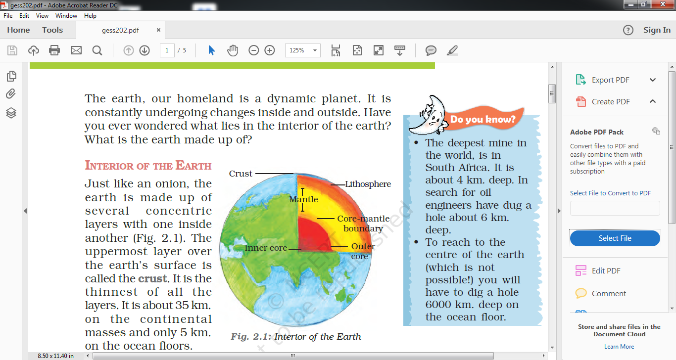
WHAT ARE THE SOURCES ABOUT THE EARTH INTERIOR ?
THERE ARE TWO SOURCES ABOUT THE EARTH INTERIOR -----
DIRECT SOURCES----
The most easily available solid earth material is surface rock or the rocks we get from mining areas. Gold mines in South Africa are as deep as 3 - 4 km. Going beyond this depth is not possible as it is very hot at this depth.
Besides mining, scientists have taken up a number of projects to penetrate deeper depths to explore the conditions in the crustal portions. Scientists world over are working on two major projects such as “Deep Ocean Drilling Project” and “Integrated Ocean Drilling Project”.

Slide 3
The deepest drill at Kola, in Arctic Ocean, has so far reached a depth of 12 km. This and many deep drilling projects have provided large volume of information through the analysis of materials collected at different depths.
Volcanic eruption forms another source of obtaining direct information. As and when the molten material (magma) is thrown onto the surface of the earth, during volcanic eruption it becomes available for laboratory analysis. However, it is difficult to ascertain the depth of the source of such magma.

Slide 4
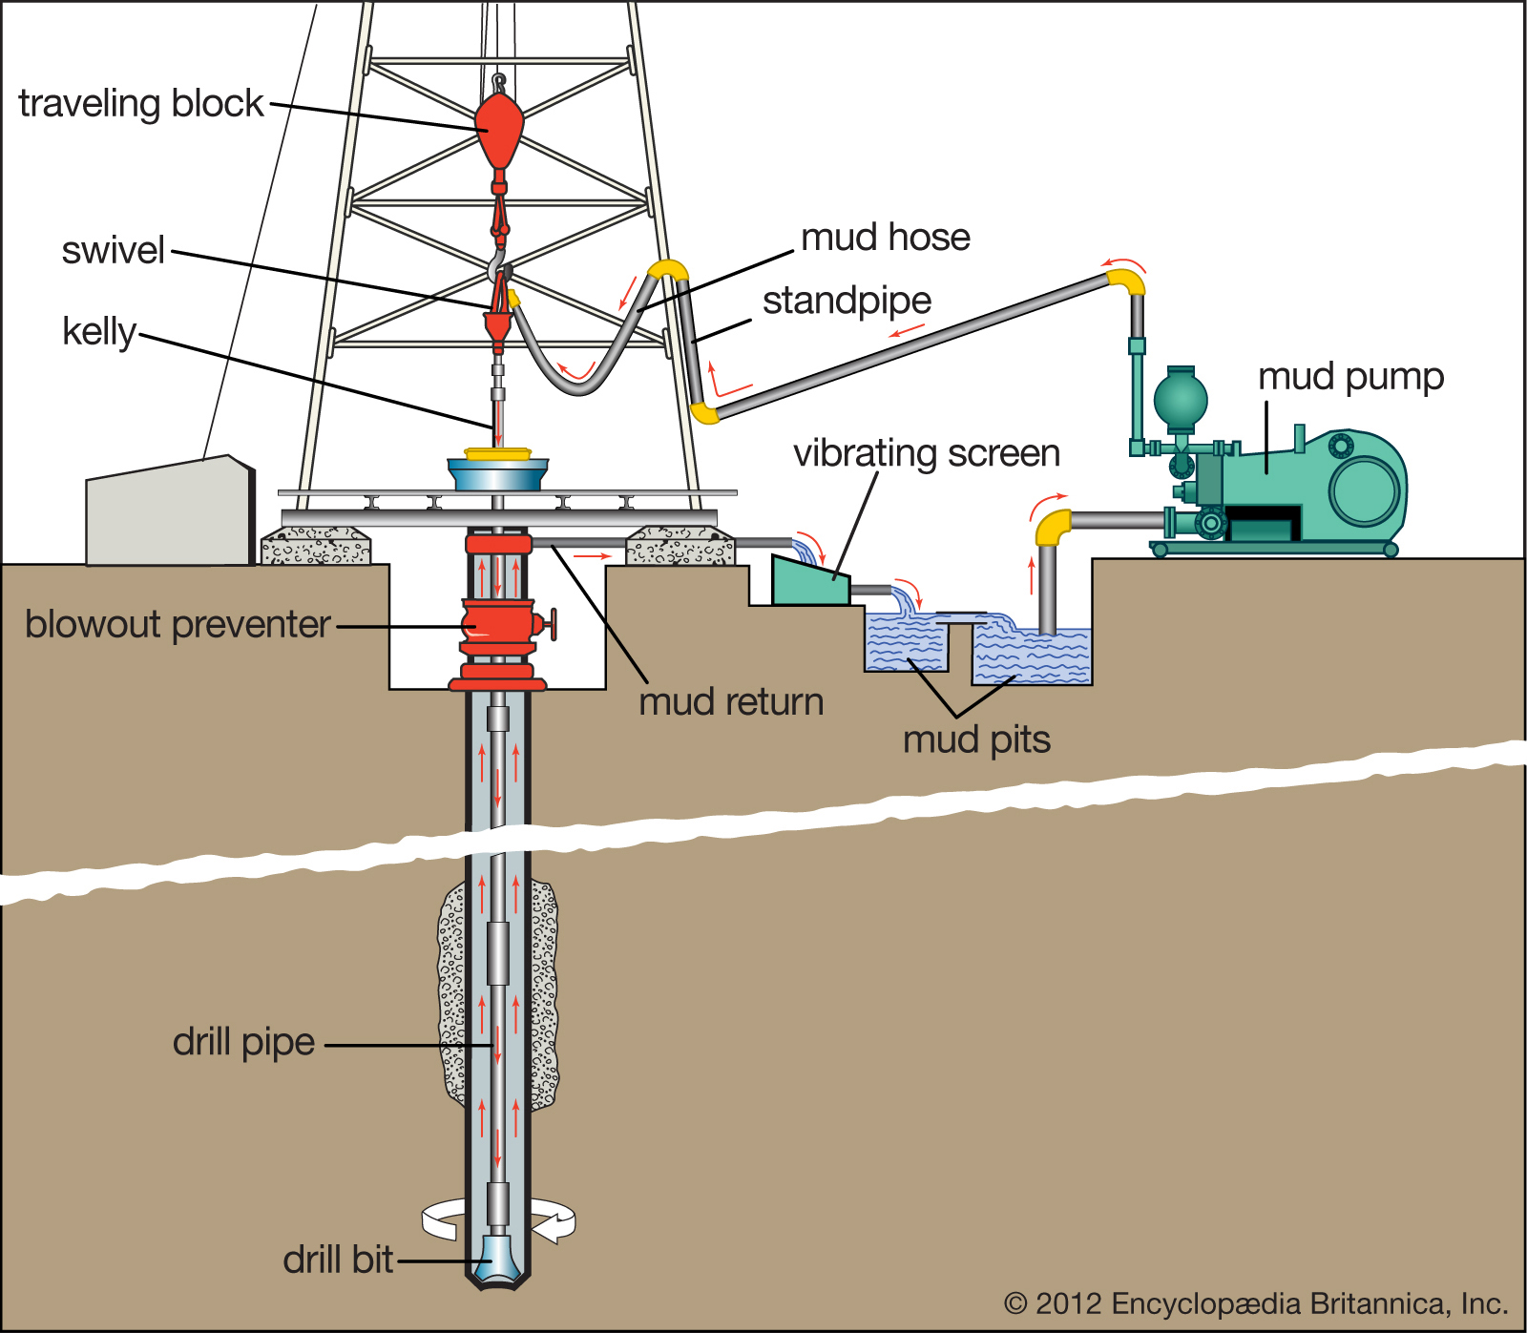

Slide 5
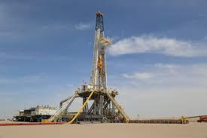

Slide 6
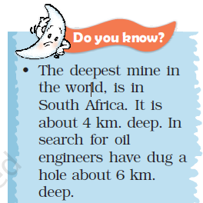
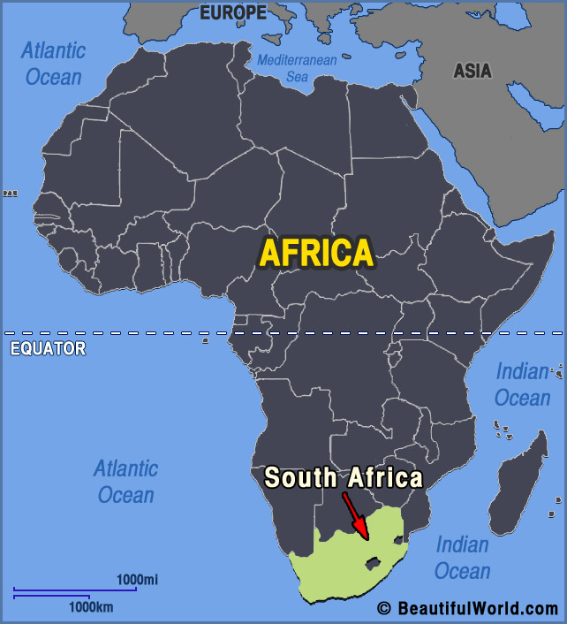

Slide 7
INDIRECT SOURCES
Analysis of properties of matter indirectly provides information about the interior. We know through the mining activity that temperature and pressure increase with the increasing distance from the surface towards the interior in deeper depths. Moreover, it is also known that the density of the material also increases with depth. It is possible to find the rate of change of these characteristics. Knowing the total thickness of the earth, scientists have estimated the values of temperature, pressure and the density of materials at different depths

Slide 8
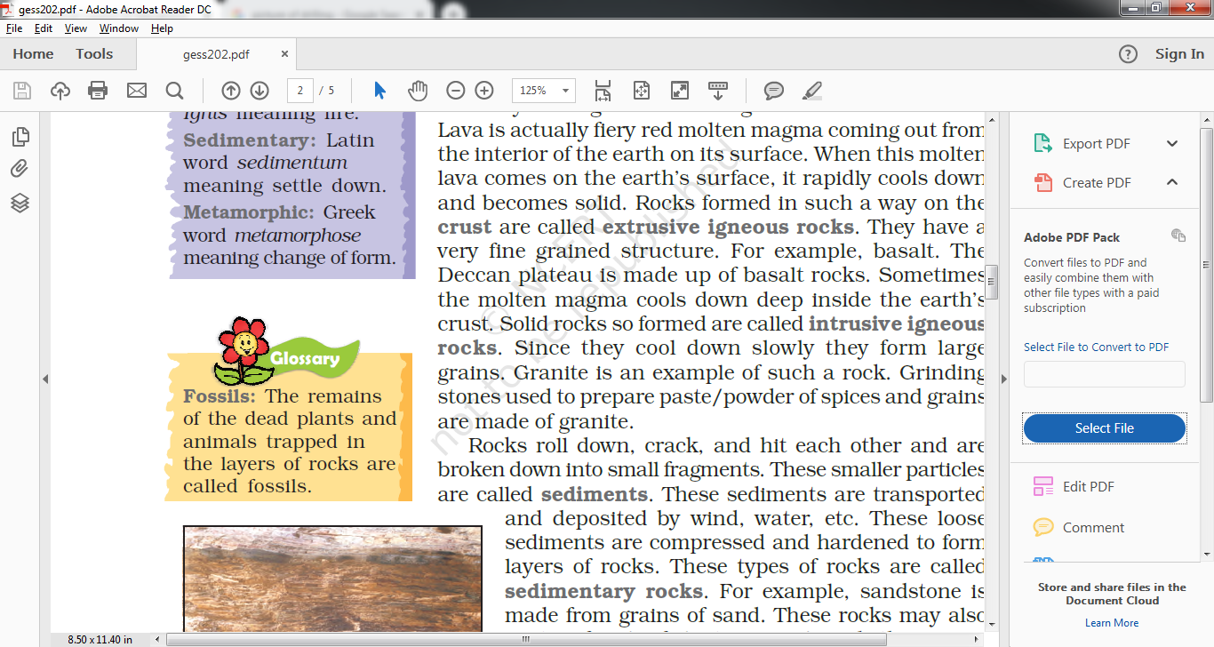
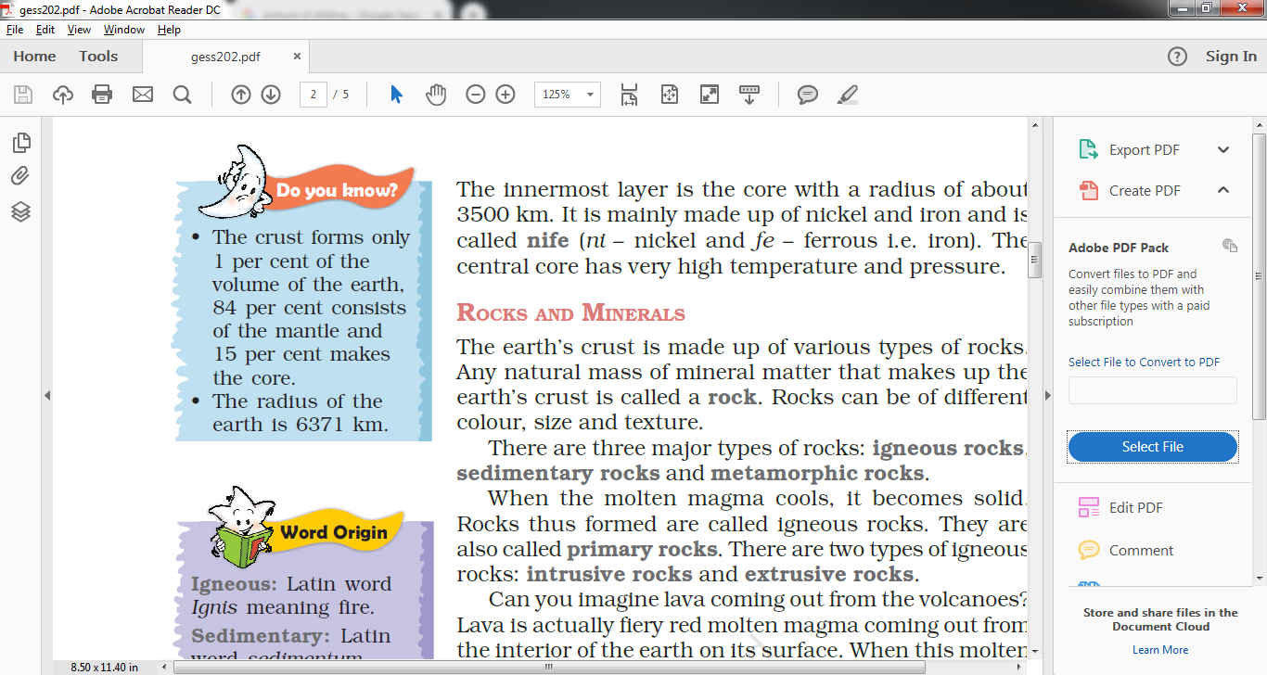

Slide 9
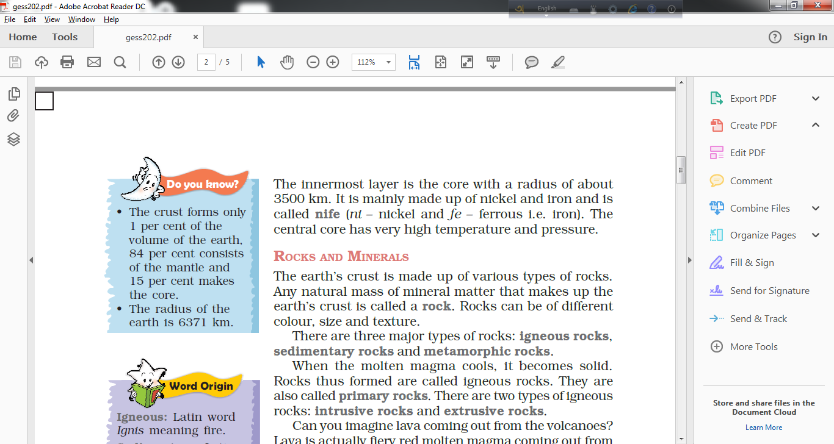
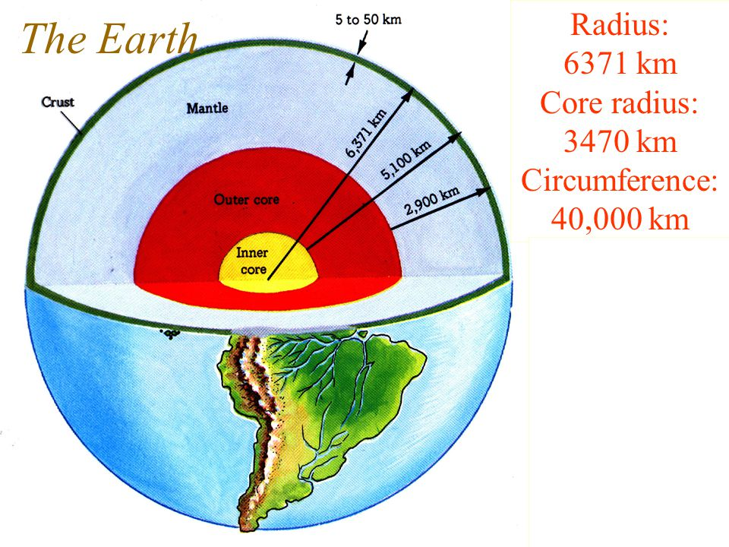
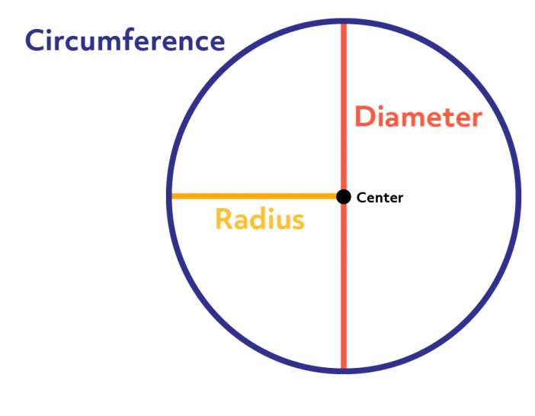

Slide 10
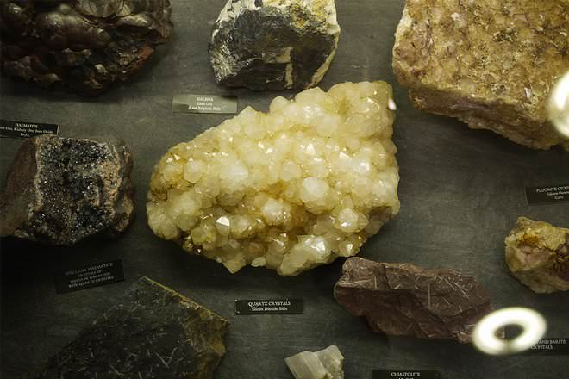
MINERALS

Slide 11
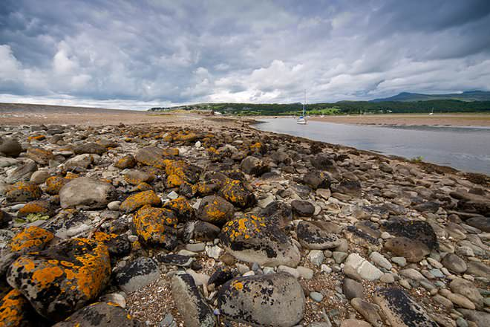
ROCKS

Slide 13
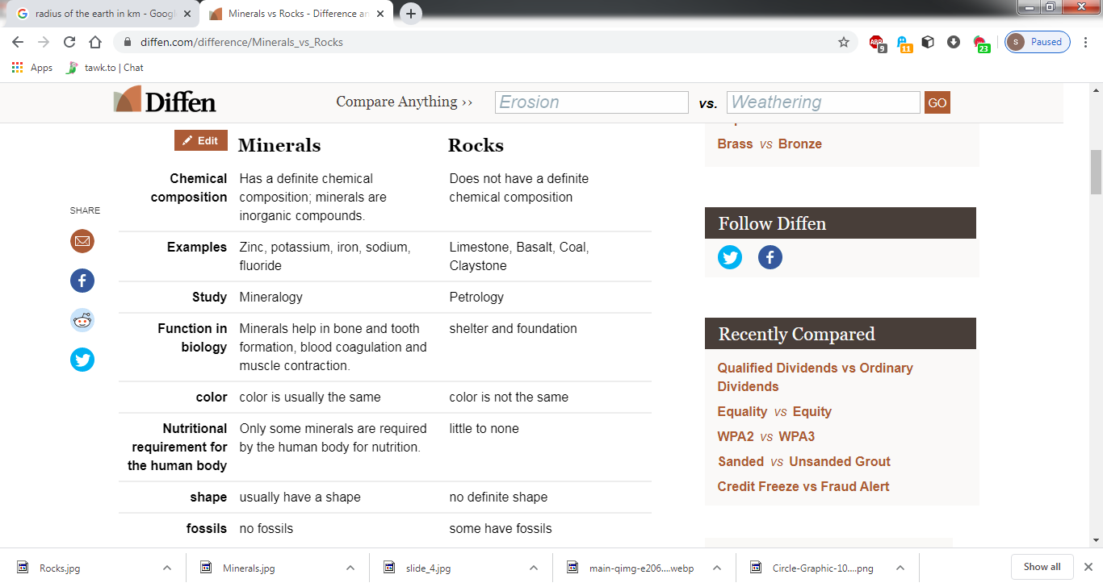
COMPARISION

Slide 14
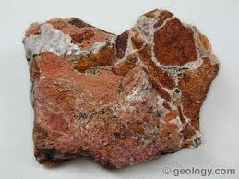
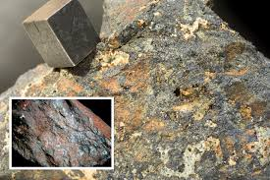
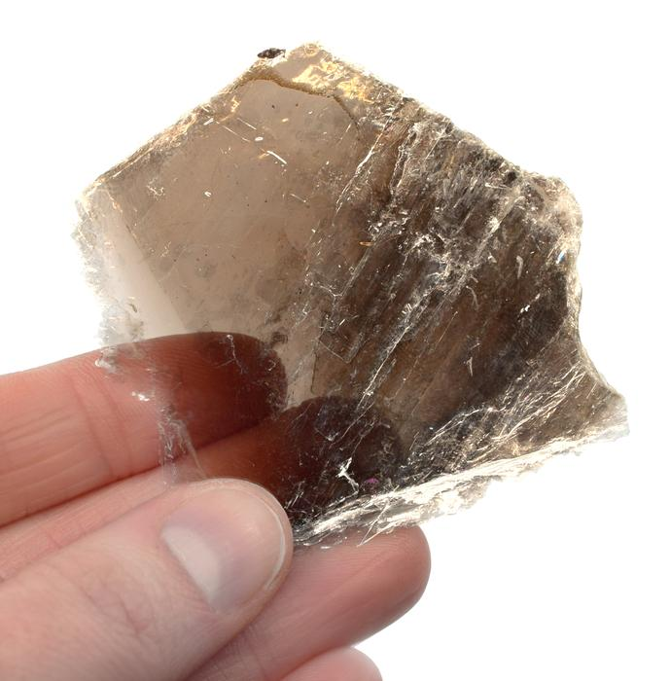
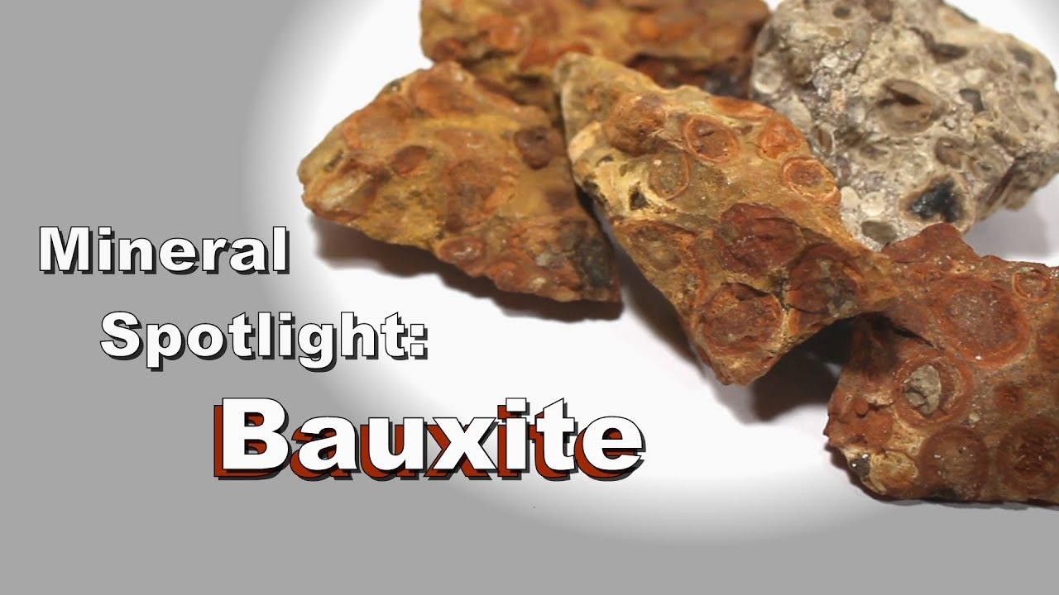
Different Minerals
Copper
Iron ore
Mica

Slide 15
