Slide 1
Doubt Clearing class
Topic: ■ Multiplication
■ Division
■ Word problem on multiplication and division

Slide 2
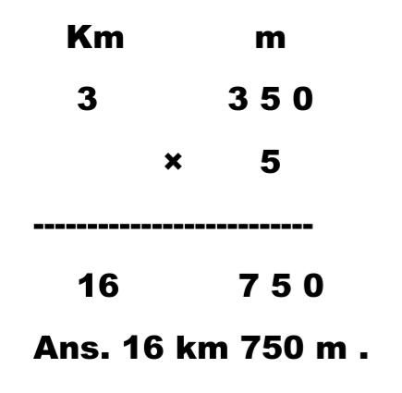
Multiply involving different units of length:
1) Arrange in column and multiply :
3 km 350 m by 5 = ?
Solution :

Slide 3
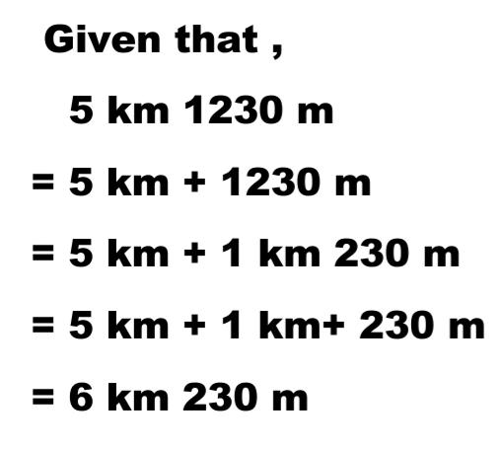
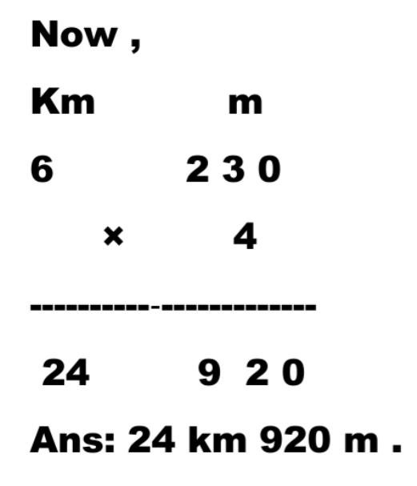
2 ) Arrange in column and multiply :
5 km 1230 m by 4 = ?

Slide 4
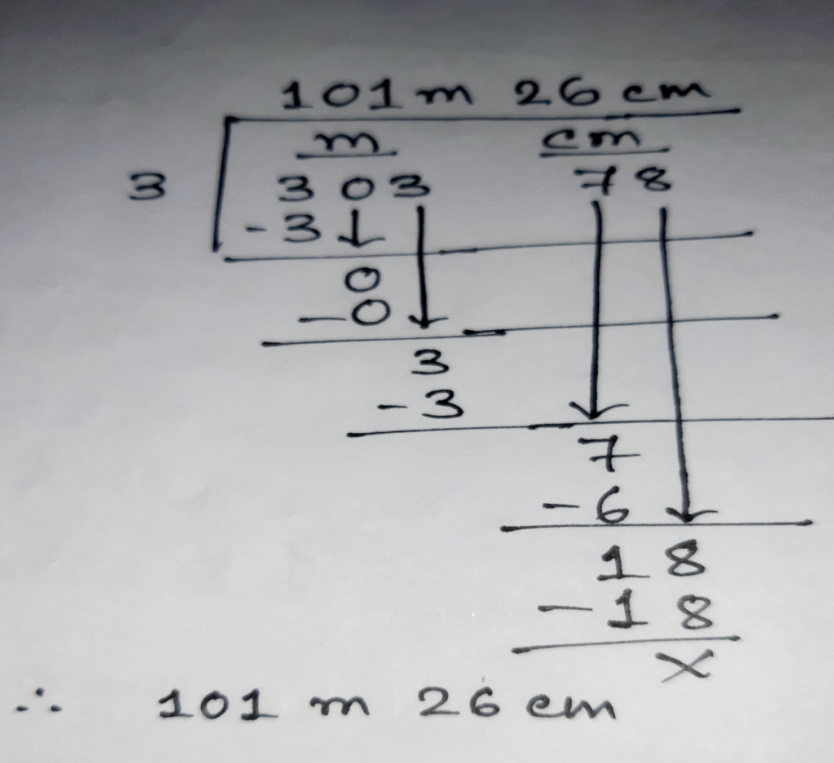
3 . Divide 303 m 78 cm by 3 .

Slide 5
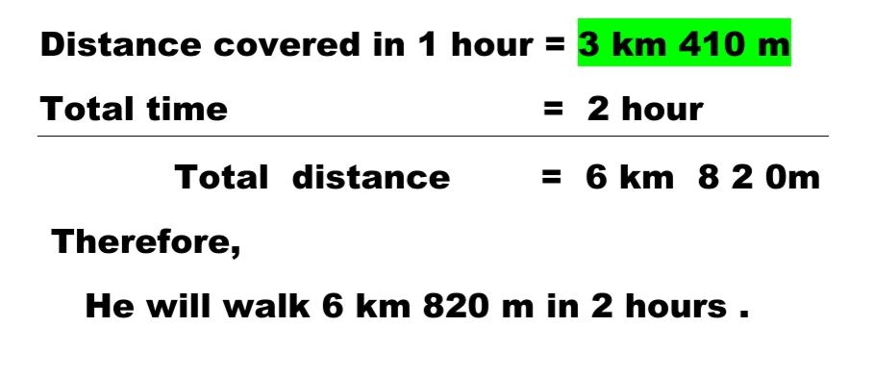
4 ) A boy walks 3 km 410 m in an hour . How far will he walk in 2 hours ?

Slide 6
5) A rod is 12 m long . It is broken into four equal pieces . What is the length of each piece ?
Solve it

Slide 7
Solve :
1 ) Multiply 7 5 0 m × 5 = ….. Km ……. m
2 ) Divide : 125 m 75 cm by 5 .

Slide 8
Thank you

